Slide 1
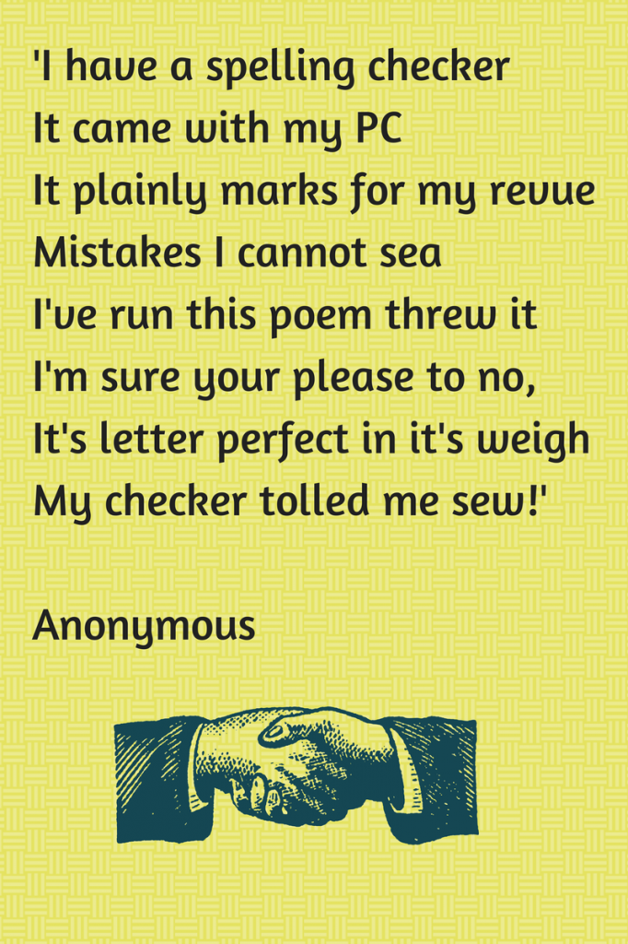
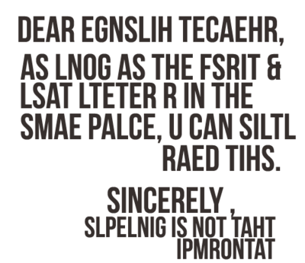
Welcome!
Please complete the questionnaire while you are waiting, thank you. We will be doing a short presentation and then games

Slide 2
English Parent forum:
Spelling and handwriting
Wednesday 25th September 2019

Slide 3
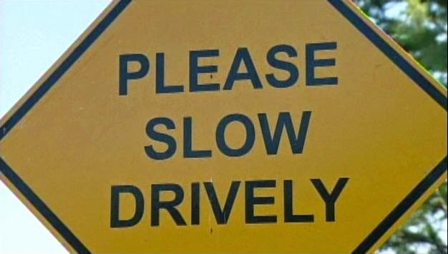
Why is spelling so important?
Make a good impression many people- particularly employers- will likely make judgements on misspellings. It can impact how seriously you are taken
Be professional misspelled emails or signs could mean people are less likely to follow or respect what you have said
Secure the job you want misspelled job applications could be the difference between getting a the job you want the most, or missing an opportunity.

Slide 4
Why is spelling so important?
Attainment For the children at our school, competency in spelling will impact their attainment.
For children to achieve ARE at the end of KS2, they must show evidence of accurate spelling in their work.

Slide 5
Expectations
Use knowledge of spelling rules to spell an increasing range of spellings correctly (the progression for learning these rules can be found in the National Curriculum and is available for you to take away with you today)
KS1: To spell the common exception words correctly for their year group
KS2: To spell the statutory words for their year group correctly in their work (Lists of these words are available for you to take away with you today)
By the end of KS2 children can edit their work for misspellings and edit them accordingly

Slide 6
How do we do this?
Daily phonics lessons in EYFS, year 1 and year 2
Daily spelling lessons (From year 2 → 6) following ‘No-Nonsense Spelling’ programme and teaching spelling rules and including practise of statutory words for KS2 and common exception words for year 2.
Editing opportunities to address misspellings within written work and practise ‘personal’ spellings
A fun and practical approach to learning the set words for each year group (culminating in the SPELLING BEE)

Slide 7
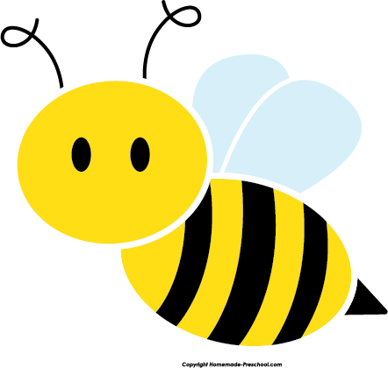
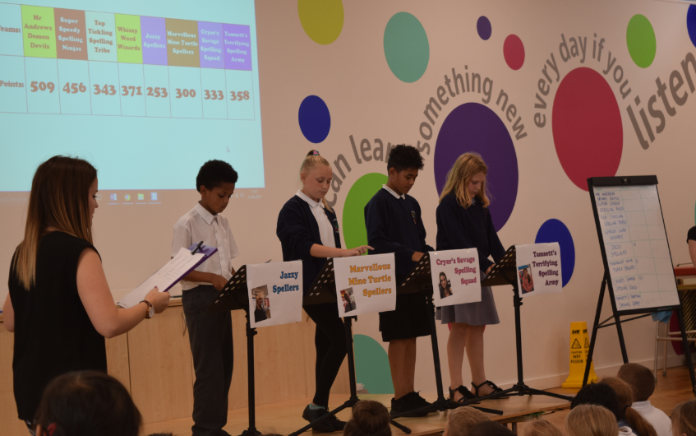
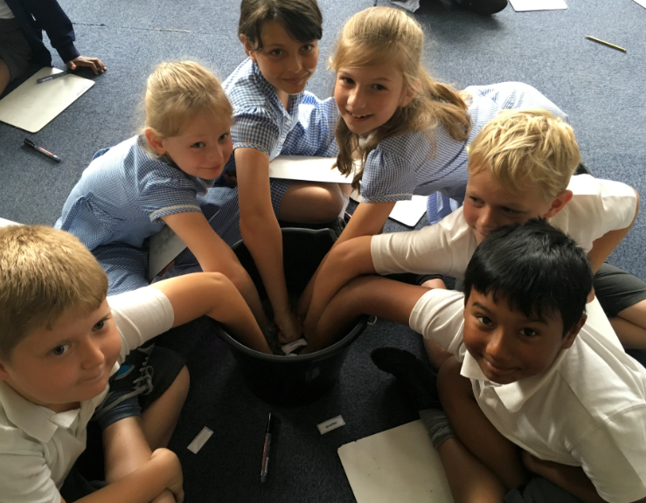
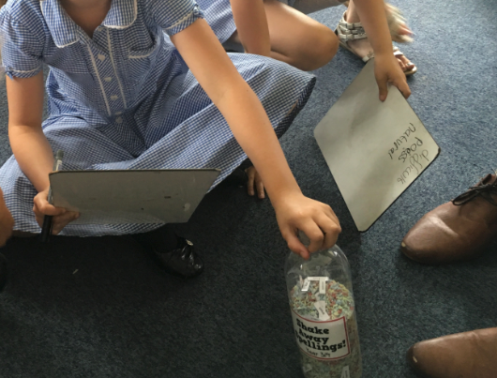
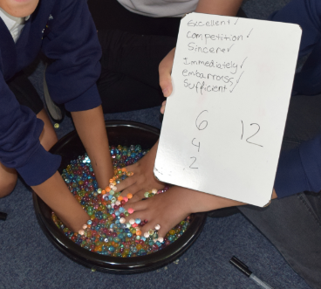
The spelling bee!

Slide 8
This year…
We will be launching the spelling bee much earlier
Children will be practicing in their groups throughout the year
The main event in the summer term will determine the ultimate winners
Practicing at home as well as at home will be key…

Slide 9
Practicing at home
One of the best things you can do at home is to help your children practise the words from their year group’s list (these can be found on the school website)
Today we hope to highlight a few ways you can do this
Most of what you will see or hear about today can be found on the school website:
Home → School information → Curriculum → English → Spelling and phonics

Slide 10
Useful websites
www.spellzone.com
www.spellingshed.com

Slide 11
Handwriting
A progression is followed and repeated through the infants and into the juniors when necessary (handout available)
By the end of Year 1 children need to
Sit correctly at a table, holding a pencil comfortably and correctly
Begin to form lower-case letters in the correct direction, starting and finishing in the correct place
Form capital letters and digits
Understand which letters belong to which handwriting ‘families’

Slide 12
Handwriting
By the end of Year 2 children need to
Form lower-case letters of the correct size relative to one another
Write capital letters and digits of the correct size, orientation and relationship to one another and to lower case letters
Use spacing between words that reflects the size of the letters
Use some of the diagonal and horizontal strokes needed to join letters and understand which letters, when adjacent to one another, are best left unjoined.

