Slide 1
Welcome
Phonics and reading parent forum, November 2022
So it is with children who learn to read fluently and well: they begin to take flight into whole new worlds as effortlessly as young birds take to the sky. – William James

Slide 2
Aims of the session
Ethos
What is phonics?
How we teach phonics at Oakridge- Little Wandle
Reading for pleasure
Reading at home
Here to help!

Slide 3
Ethos

Slide 4
Reading changes lives
There is considerable research to show that children who enjoy reading and choose to read, benefit not only academically but socially and emotionally too.
High quality, consistent teaching of early reading for every child in every classroom so that we open the gateway as soon as possible for our children.
Reading is essential for all subject areas.
Notes:
At Oakridge we recognise… therefore our ethos is:

Slide 5
Learn to read, read to learn
Learning environments that celebrate reading and inspire a love of reading for pleasure through the sharing of diverse texts and the availability of quality resources
High expectations about the importance of reading at home
Teachers who are role model readers
Notes:
As well as the high quality teaching of early reading, we strive to foster a love of reading from the very beginning so that our children can recognise the many benefits reading can bring. The characters, conversations, themes and experiences born from sharing books become the corner stone to the school day. We recognise the power we have as adults to influence the children’s attitude to reading and therefore have high expectations about reading at home. We want to support you (our families) in developing positive relationships, habits and routines that centre around reading and books. No matter your experience, you can be the change.

Slide 6
Why phonics?
To be able to read, children need to be taught an efficient strategy. That strategy is phonics.
Children should use phonics as the route to decode (read) words.
Notes:
So, what is phonics/why phonics?

Slide 7
So what is phonics?
seat
s
t
ea
Spoken sounds (phonemes)…
…can be represented by letters to form words

Slide 8
seat
1
2
3
In the word ‘seat’ we can hear 3 phonemes (sounds).
Each phoneme is represented by a ‘grapheme’
A grapheme is a letter or a combination of letters that represent one sound.

Slide 9
Terminology
s w e e t s
n i g h t
A grapheme with 2 letters is called a digraph
A grapheme with 3 letters is called a trigraph

Slide 10
Not a test- I promise!
cake
chip
fish
strawberry
bread

Slide 11
Not a test- I promise!
cake
chip
fish
strawberry
bread

Slide 12
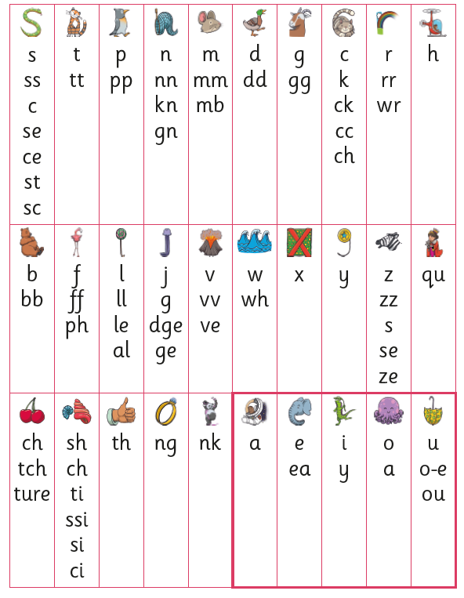
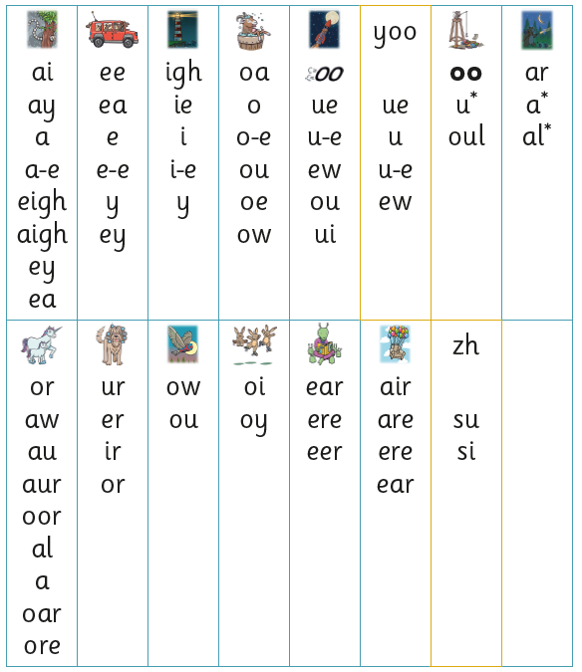
Complicated stuff…
There are 45 sounds for children to learn…
…but each sound has multiple graphemes.

Slide 13
For example…
green
carry
sea
donkey
…the /ee/ sound can correspond to 6 graphemes
relax
athlete

Slide 14
A note on tricky words…
my
they
she
was
Notes:
There are of course some words that we need to teach by sight because they contain unusual graphemes that the children won’t learn until a bit later on in the programme. These are the type of words that we are using all the time in our spoken language such as.
We teach the tricky words progressively throughout the phonics programme, discussing with children why they are tricky and providing plenty of opportunities for them to learn them and recognise them automatically by sight. This is something you could help your children with at home and a list of the tricky words and where they are taught is included in the progression, which is in your pack.

Slide 15
Phonics teaching is…
Teaching children the sounds
Progressively teaching the corresponding graphemes
Teaching children to recognise the sounds within words so that they can segment and then blend the word in order to read it

Slide 16
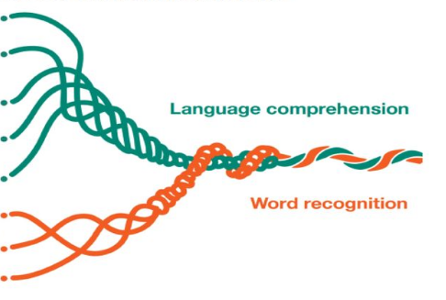
What next?
90 words per minute
Once children are doing this automatically, they will be able to read with fluency.
Once children are reading fluently, there will be space in their working memory to comprehend what they are reading. This is called ‘reading for meaning.’
It is at this point they can start to enjoy what they are reading and read for pleasure.
Notes:
Above you can see a model called ‘the reading rope’ which shows how the two main skills we need to become a competent reader are intertwined. The top strand is about understanding what you’re reading about and the lower strand is the decoding bit- so the phonics bit. As you can see, they start off as two separate strands which eventually become one.

Slide 17
Phonics teaching at Oakridge
Last year we introduced a new phonics programme called ‘Little Wandle Letters and Sounds’

Slide 18
Phonics at Oakridge
Daily 30 minute whole class phonics lessons in Reception and Year 1
3 times weekly reading practice sessions in a small group
Regular catch-up sessions for children who fall behind
(the book they read in these sessions will be the one they can also practise at home- more about this later!)

Slide 19
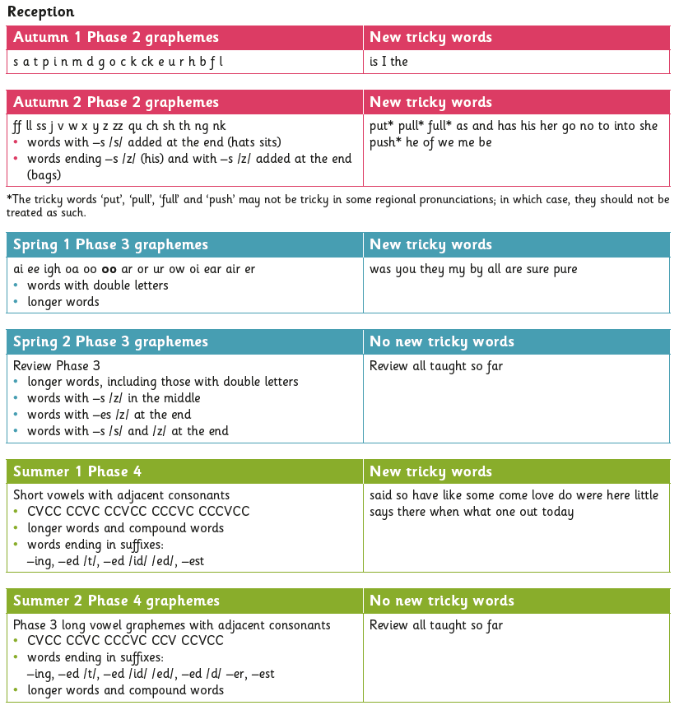
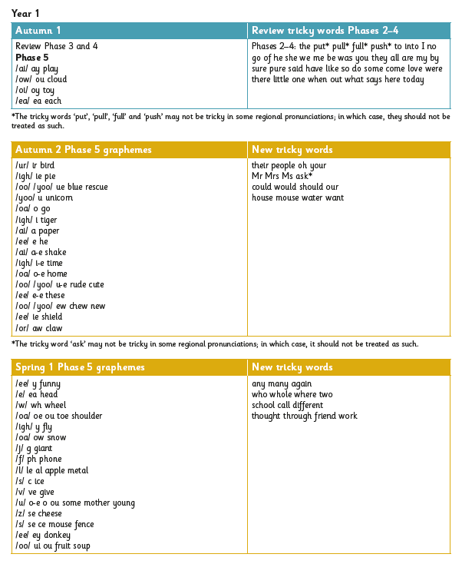
Phonics at Oakridge
The Little Wandle Letters and Sounds progression is split into 5 phases
Phase 1 is taught in pre-school
Children should have completed phase 4 by the end of year R
Children should complete phase 5 by the end of year 1. At this point we expect them to be recognising words automatically and reading with fluency

Slide 20
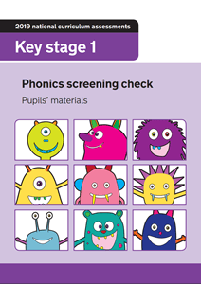
Phonics screening
It takes place at the end of Year 1 when the children should have completed the phonics programme
Any children who do not pass the phonics screening will receive additional support with their phonics in year 2
The phonics screening test is a government requirement

Slide 21
Reading for pleasure
It’s very important that while children are learning to read, they still have plenty of opportunities to share and listen to a range of quality books and stories that promote reading for pleasure.

Slide 22
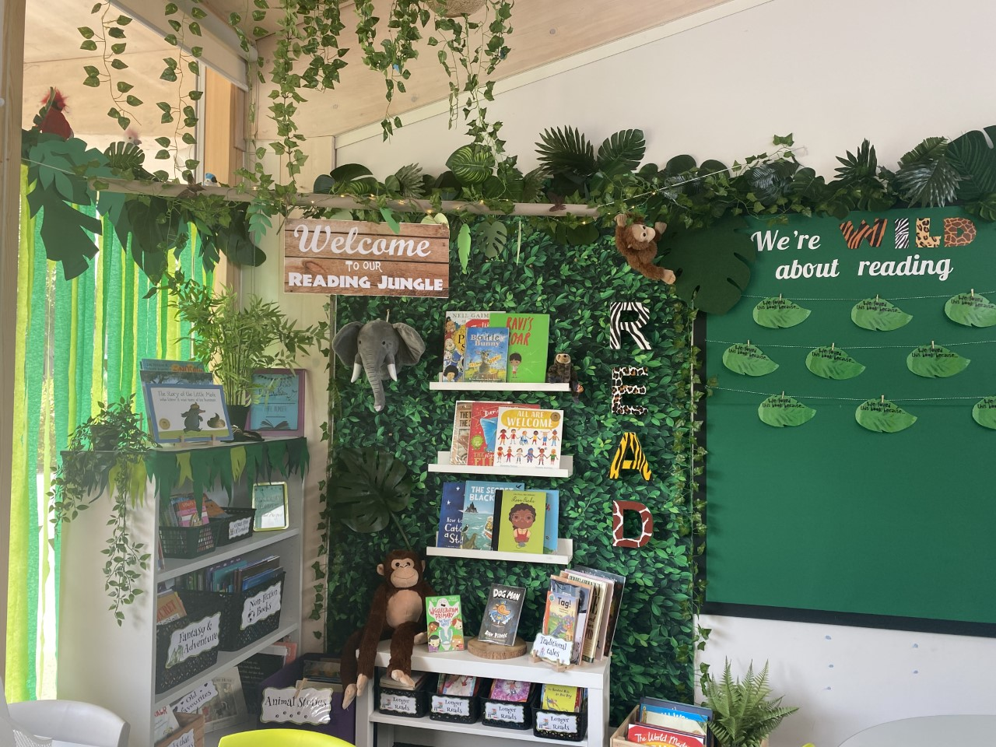
Promoting reading for pleasure
A reading spine for each year group that ensures children will hear a diverse range of fiction and non-fiction texts
Enticing classroom libraries with plenty of current quality texts
An English curriculum based on quality texts that inspire writing

Slide 23
Reading at home
Encouraging your children to read at home is really important.
Share and enjoy books together.
We appreciate you recording your child’s home reading in their reading diary.
Develop positive reading habits and routines like bedtime stories.

Slide 24
Reading at Home
2 types of book your children can read at home:
A reading practice book
A reading for pleasure book

Slide 25
The reading practice book
This will be the book your child has been reading in their phonics lesson
They should be able to read it independently
A reading practice book
It will also be accessible via an E-book platform

Slide 26
Share with me books
This is a book that your child cannot be expected to read independently.
The purpose of a share with me book is to promote reading for pleasure rather than practising the skill of decoding words.
A share with me book
They can choose ‘share with me’ books from the classroom library to enjoy with you at home but they must be returned before choosing a new one.

Slide 27
E-books
Your child’s Collins e-book login should be in the front of their reading diary.
This will give you access to the Collins E-book platform where your child can read the phonically decodable books they have been reading in class.
Your child’s teacher will be able to monitor levels of engagement and will update the assigned books in relation to what your child has been doing in class.
We’re new to this too!

Slide 28
In summary…
You
(and us!)
Us
Scarborough, H. S. (2001).
Notes:
So here’s that reading rope again. I want you to think of it as: we’ll take care of that word recognition- that phonics- part of becoming a skilled reader at school. We will make sure that your child is equipped to practise that decodable book and read it fluently by the time it comes home to you. The best best thing YOU can do is to support your child with the language part. The book talk stuff: sharing those reading for pleasure books with your children and having lots and lots of discussion about the words, themes and ideas you come across. And remember, you can learn together. If you don’t know a word or you come across something that is new or unfamiliar to you, your child is not going to judge you for taking time to find out. In fact this models the type of curiosity we want to foster in our children.

Slide 29
Here to help!
The Little Wandle website offers useful information for parents, including videos
Notes:
The Little Wandle website: https://www.littlewandlelettersandsounds.org.uk/resources/for-parents/

Slide 30
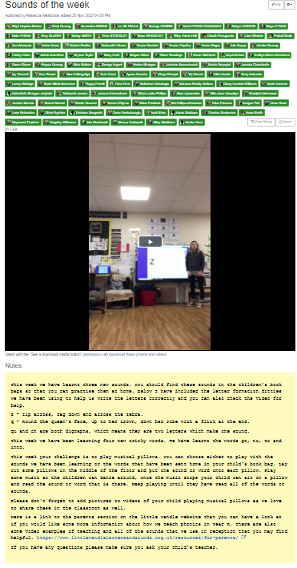
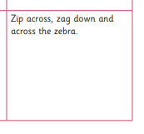
Supporting and developing learning at home
Each Friday a video is published on Tapestry which outlines the following:
The new phonemes which have been taught during the week
The letter formation ditties
The tricky words which have been taught during the week
A challenge to do together at home
Your child will have the letter cards, decodable words and tricky words in their book bag each week for you to use together at home

