Slide 1
Maths Forum
Wednesday 11th October
Focus: number bonds and times tables

Slide 2
Agenda:
Early years: Early number bond exploration and counting in small groups
KS1: Times table introduction
KS2: Times table continuation
Times Table Rockstars
Resources for you to use at home

Slide 3
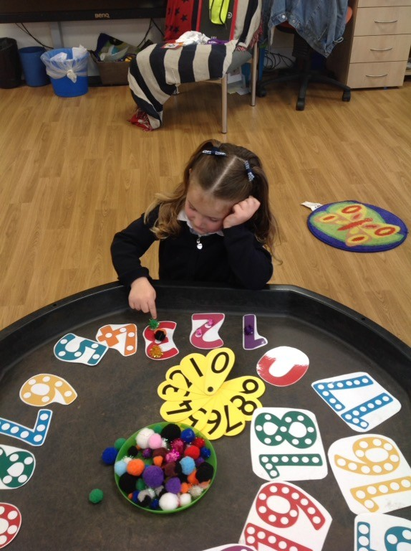
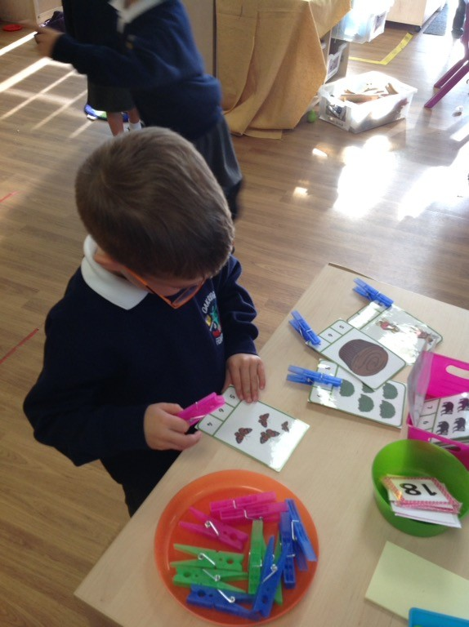
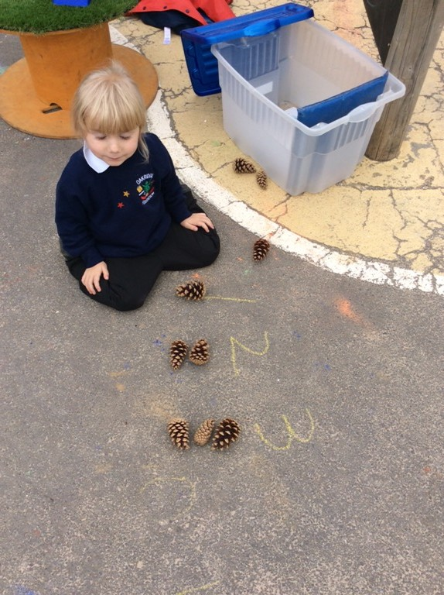
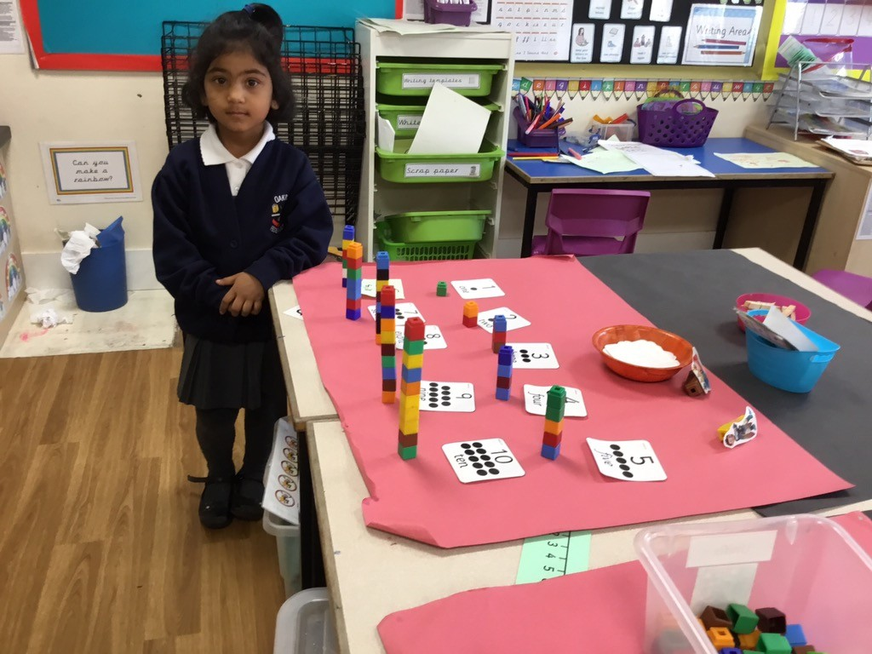
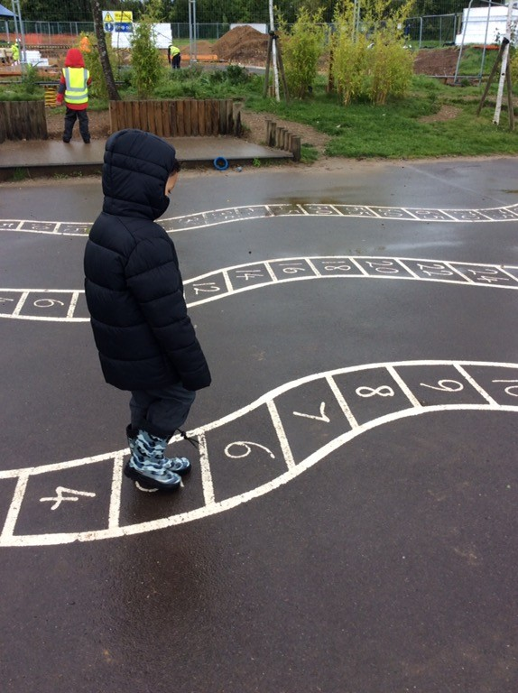
Early Years:
In order for children to develop strong number skills they must develop their skills in the three areas of number.
cardinal number-how many?
ordinal number-the position of the number in the number system
nominal number- the ‘name’ given to the number-the numeral
First of all lots and lots and lots of counting!
It is ALWAYS practical
ONLY when a child has a good understanding of these three elements will they be able to move on

Slide 4
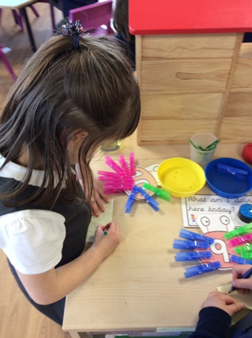
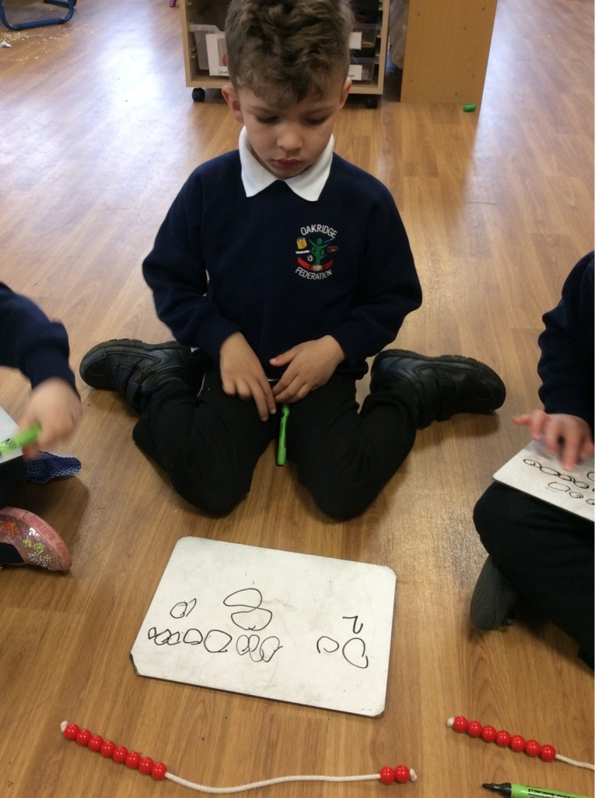
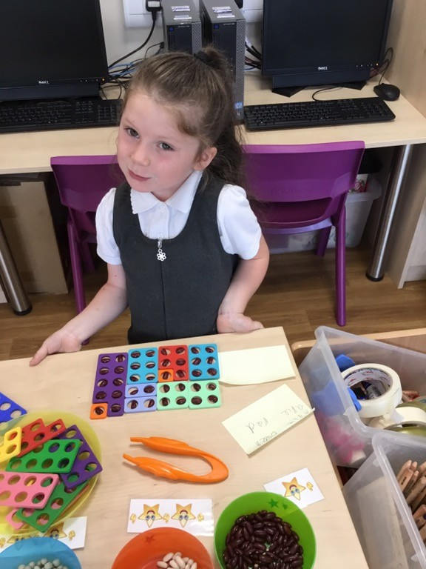
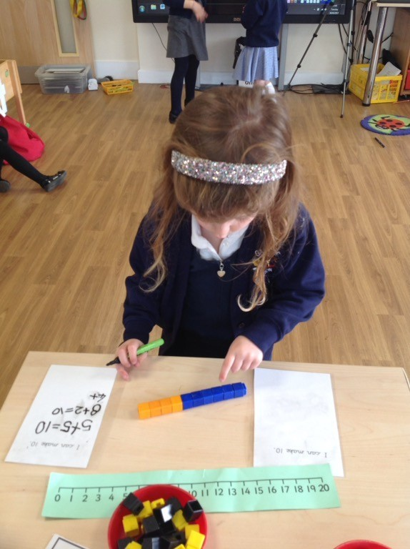
Early Years: exploring number bonds
Realising a set of objects can be split in
different ways but the
number of objects stays the same.
Number bonds to 10

Slide 5
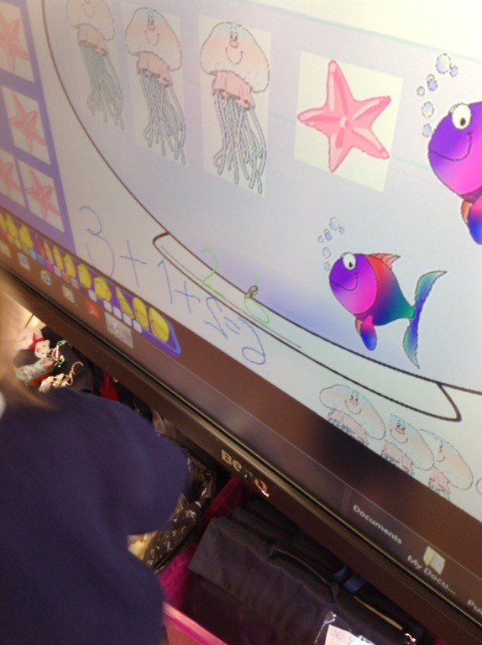
Early Years-Solving simple problems
You have three different types of fish but can only have 6 fish in your fish bowl.
Jack got ……beans in exchange for his cow. He had two beds to grow them in how many different ways could he split them?

Slide 6
Early Years-counting in groups of numbers
Begin by reciting numbers to get to know the patterns.

Slide 7
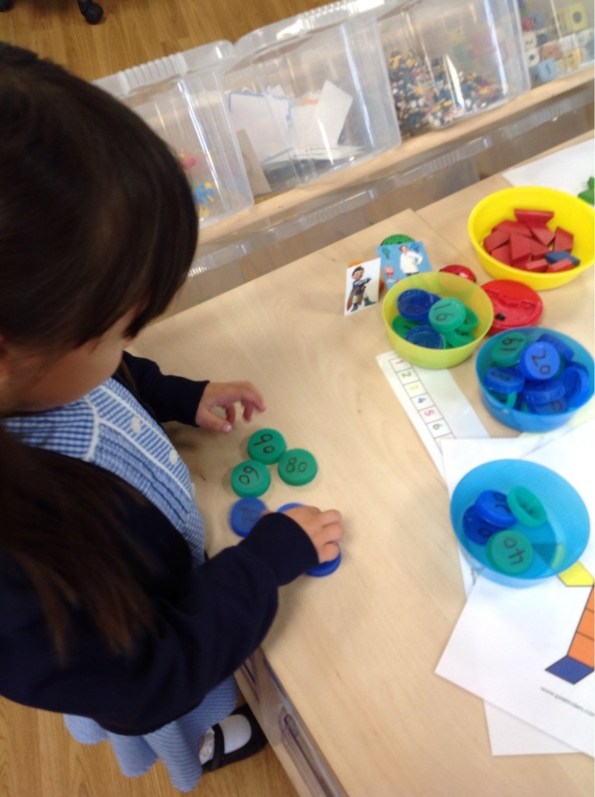
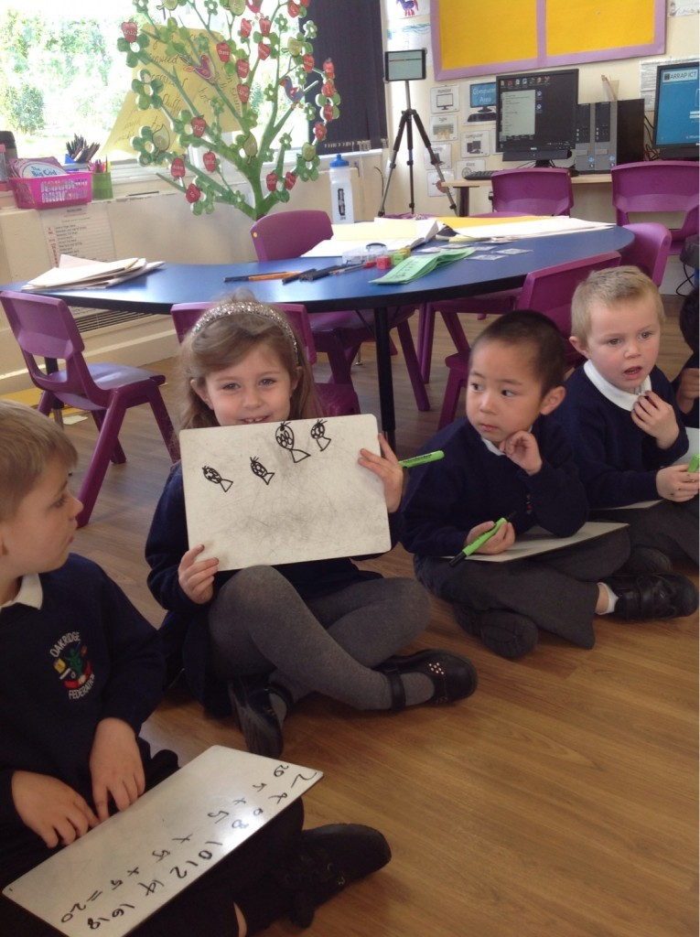
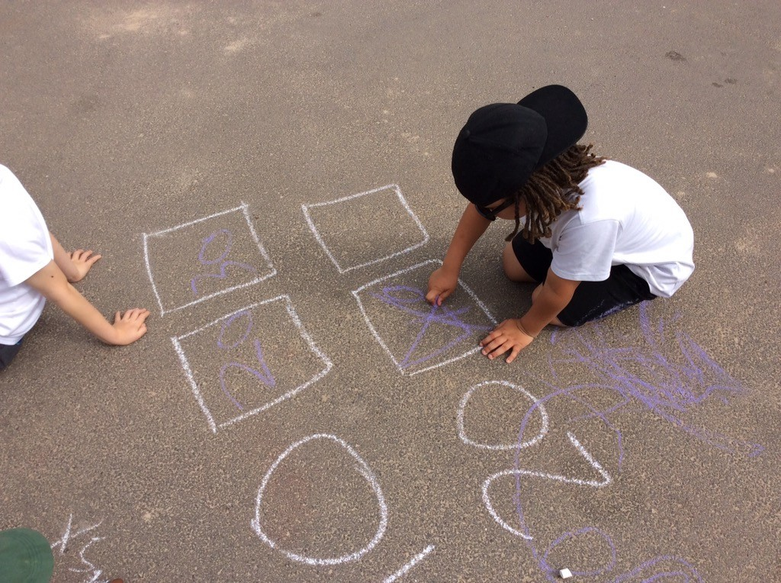
Early Years-counting in groups of numbers
Missing number sequences
Reasoning-how do you know?
Creating sequences of numbers
Noticing patterns
Solving problems
The rainbow fish had 20 shiny scales.
He shared them between 4 fish.
How many scales did each fish have?

Slide 8
Early Years-applying this knowledge and
becoming efficient mathematicians
…….. spent a long time this afternoon working out doubles and their corresponding halves. He chose to record what he had done in number sentences and was able to explain what his recordings meant. He used the cubes to help him and worked methodically and efficiently, adding one more to each tower to create his next sum. He told me "Now I can count on two (from his previous double) to find out the (next) doublehis knowledge of number bonds. "17+3 is 20. I know that because 7+3 is ten and 17 is 10 more than 7 so that makes 20 altogether."

Slide 9
KS1 Multiplication and times tables
Problems in context
Concrete equipment
Pictorial representations including arrays
Repeated addition
Learning the times tables and related division facts

Slide 10
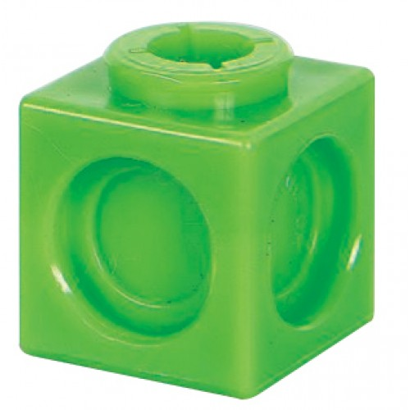
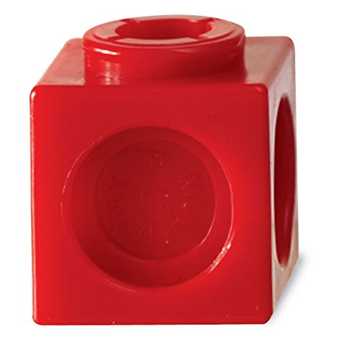
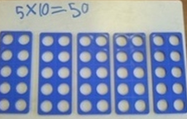
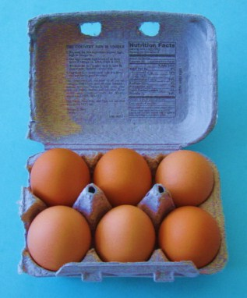
Concrete objects
Counting objects e.g cubes and multilink
Numicon
Concrete objects for arrays
2 lots of 2 = 4
2 x 2 = 4

Slide 11
Pictorial representations
Groups
Arrays
3 lots of 2 = 6
3 x 2 = 6
4 lots of 2 = 8
4 x 2 = 8

Slide 12
Repeated addition
4 lots of 2 = 8
4 x 2 = 8
2 + 2 + 2 + 2 = 8

Slide 13
Ks2 Times tables:
Continues on from KS1
Known facts are so important for other topics in maths
Speed – preparation for year 6 SATs
Move on to the division facts when ready

Slide 14
How we teach times tables in lessons:
Times Table Rockstars
Teaching the children patterns and relationships between numbers using number squares

Slide 15
Example:
If we look at the 8 times table, we can highlight
the numbers that appear
We then look at patterns/things we notice about
the numbers
Here they end with 8, 6, 4, 2, 0 and repeat this pattern
Why do they end with these digits?
Discuss how numbers in the 8 times table
are also in the 4 and 2 times tables
Children explore the numbers to see the relationships
between them

Slide 16
- Arithmetic sessions then focus on the use of these facts
E.g. 8 ½ x 5 =
Other topics use these multiplication facts
E.g. area of rectangles = L x W (multiplication)
Division will require knowledge of times tables, especially when it gets to short division later on in KS2

Slide 17
Extension:
When they know up to 12 by 12 multiplication facts, turn to the division facts

Slide 18
Times table rockstars
Avatars and earning ‘money’
Daily practise sessions from Year 2 – Year 4
Weekly assessments
Fun games to play at home
Your turn

Slide 20
Your turn

Slide 21
How you can help at home
Times table rockstars
Use the resources given to practise the times tables
Relevant division facts can be practised

