Slide 1
Maths Workshop Wednesday 5th October 2016
Our Main Aims:
Explore what maths looks like in the classroom from Early Years through to KS2
Explore what you can do as parents to help your child in maths
Explore the KS2 SATs so you know what it entails and what the end goal is for your children

Slide 2
Maths in the Early Years.

Slide 3
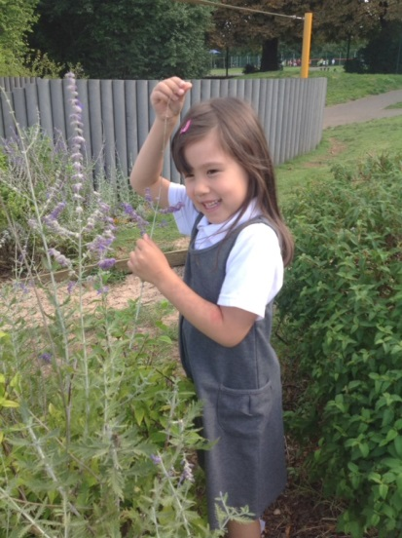
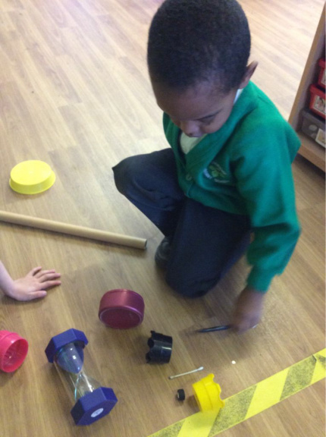
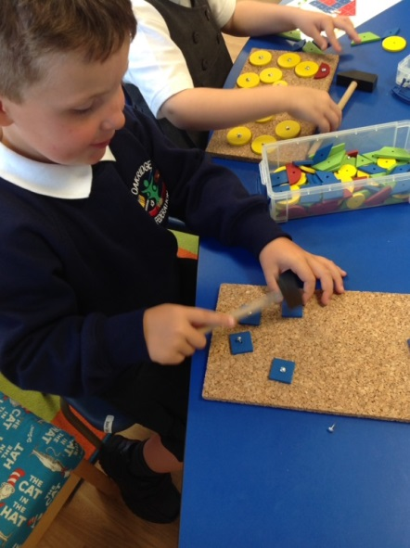
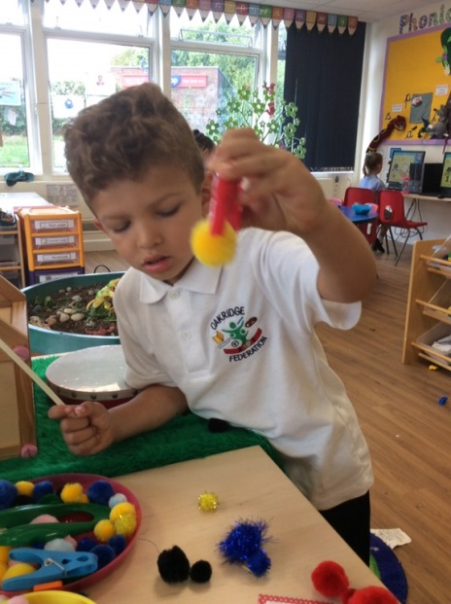
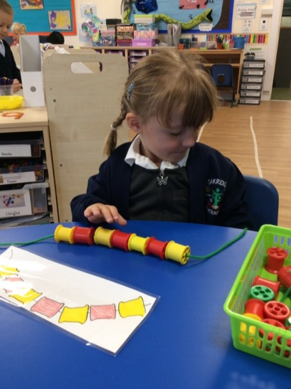
What does maths look like in an Early Years classroom?
It is..........
Measuring-”This plant is as tall as me.”
Sorting and matching
Making patterns

Slide 4
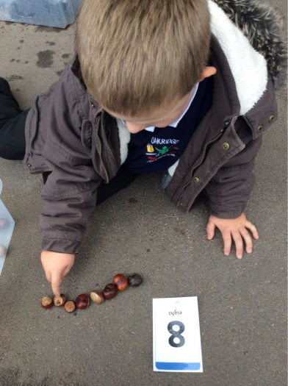
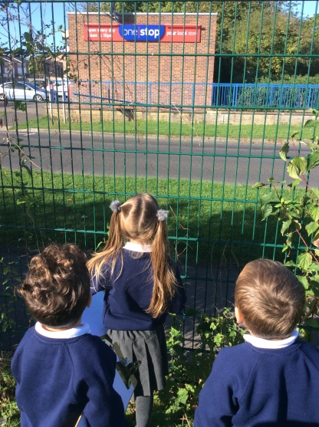
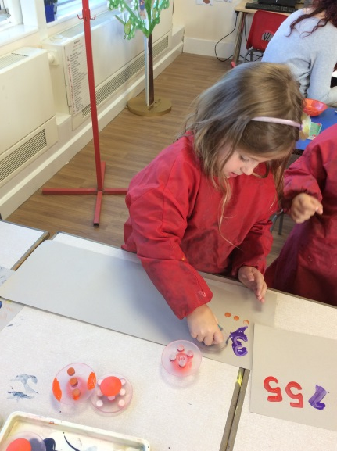
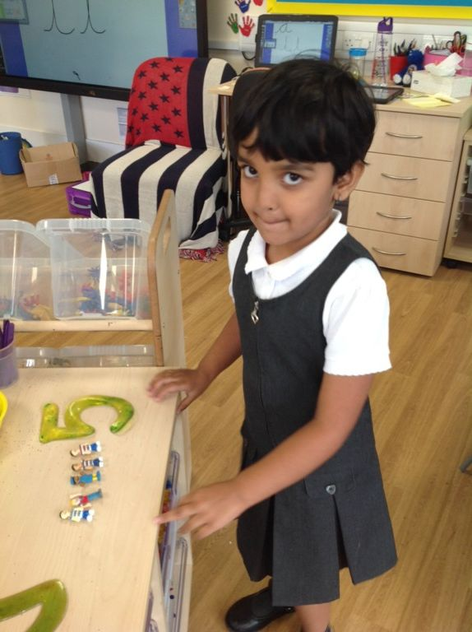
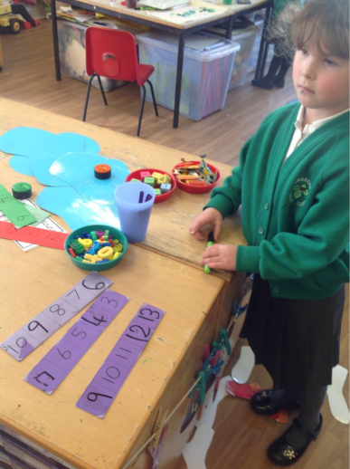
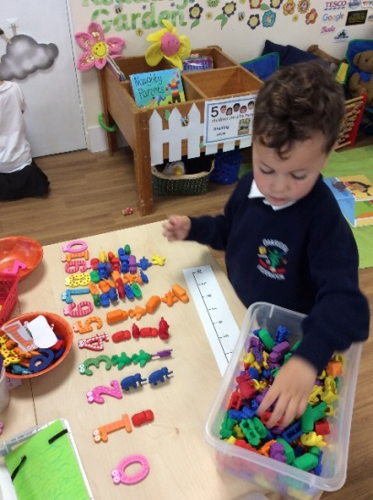
It is...
Developing an awareness of numbers.
Accurate counting.
Recognising numbers and making sets.
Ordering numbers.
Notes:
What does maths look like in an early years classroom?

Slide 5
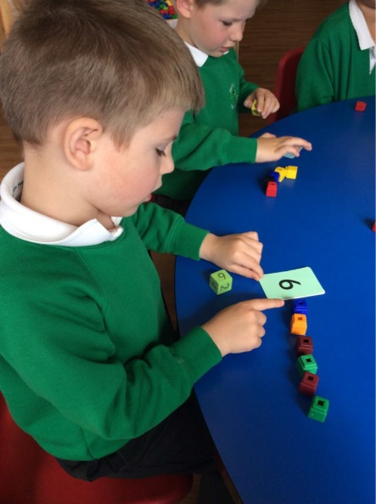
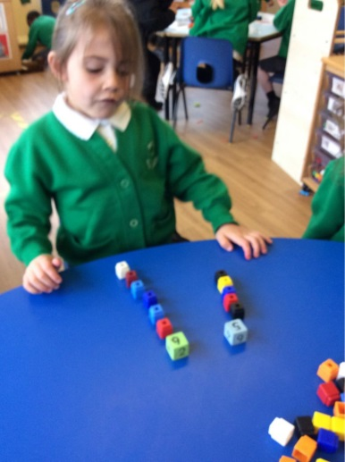
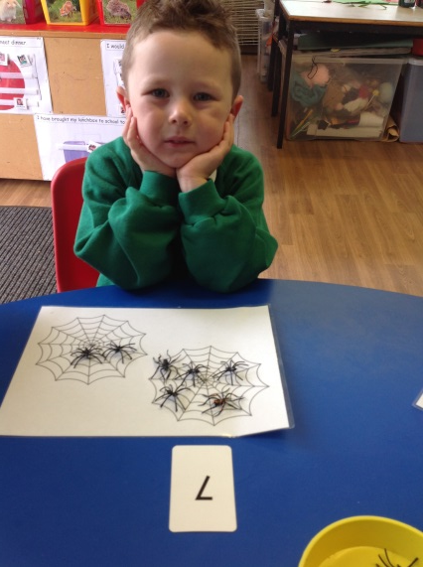
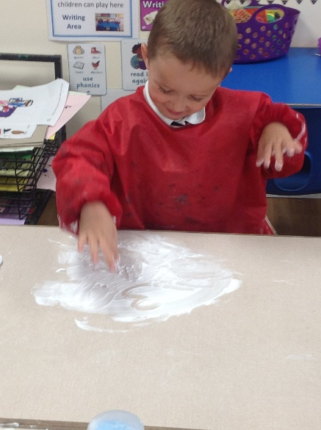
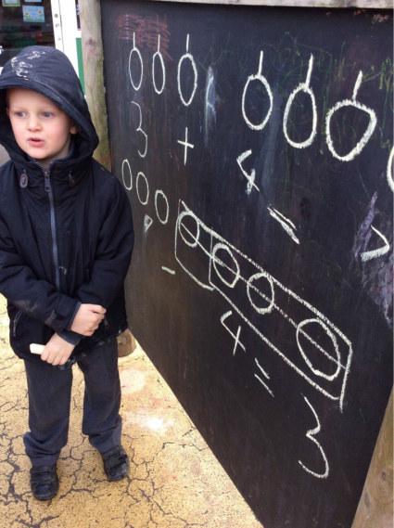
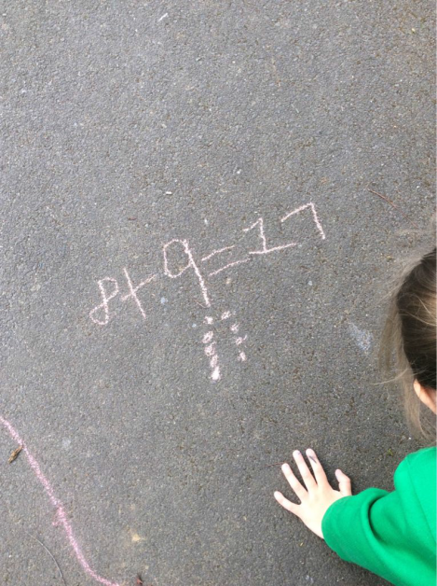
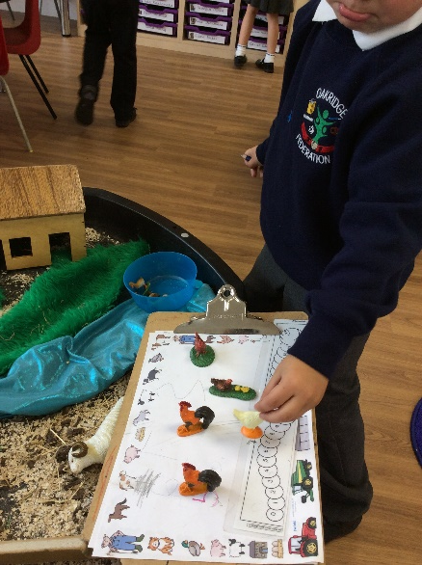
It is...
Writing numbers
Beginning to calculate
Recording what we have done.

Slide 6
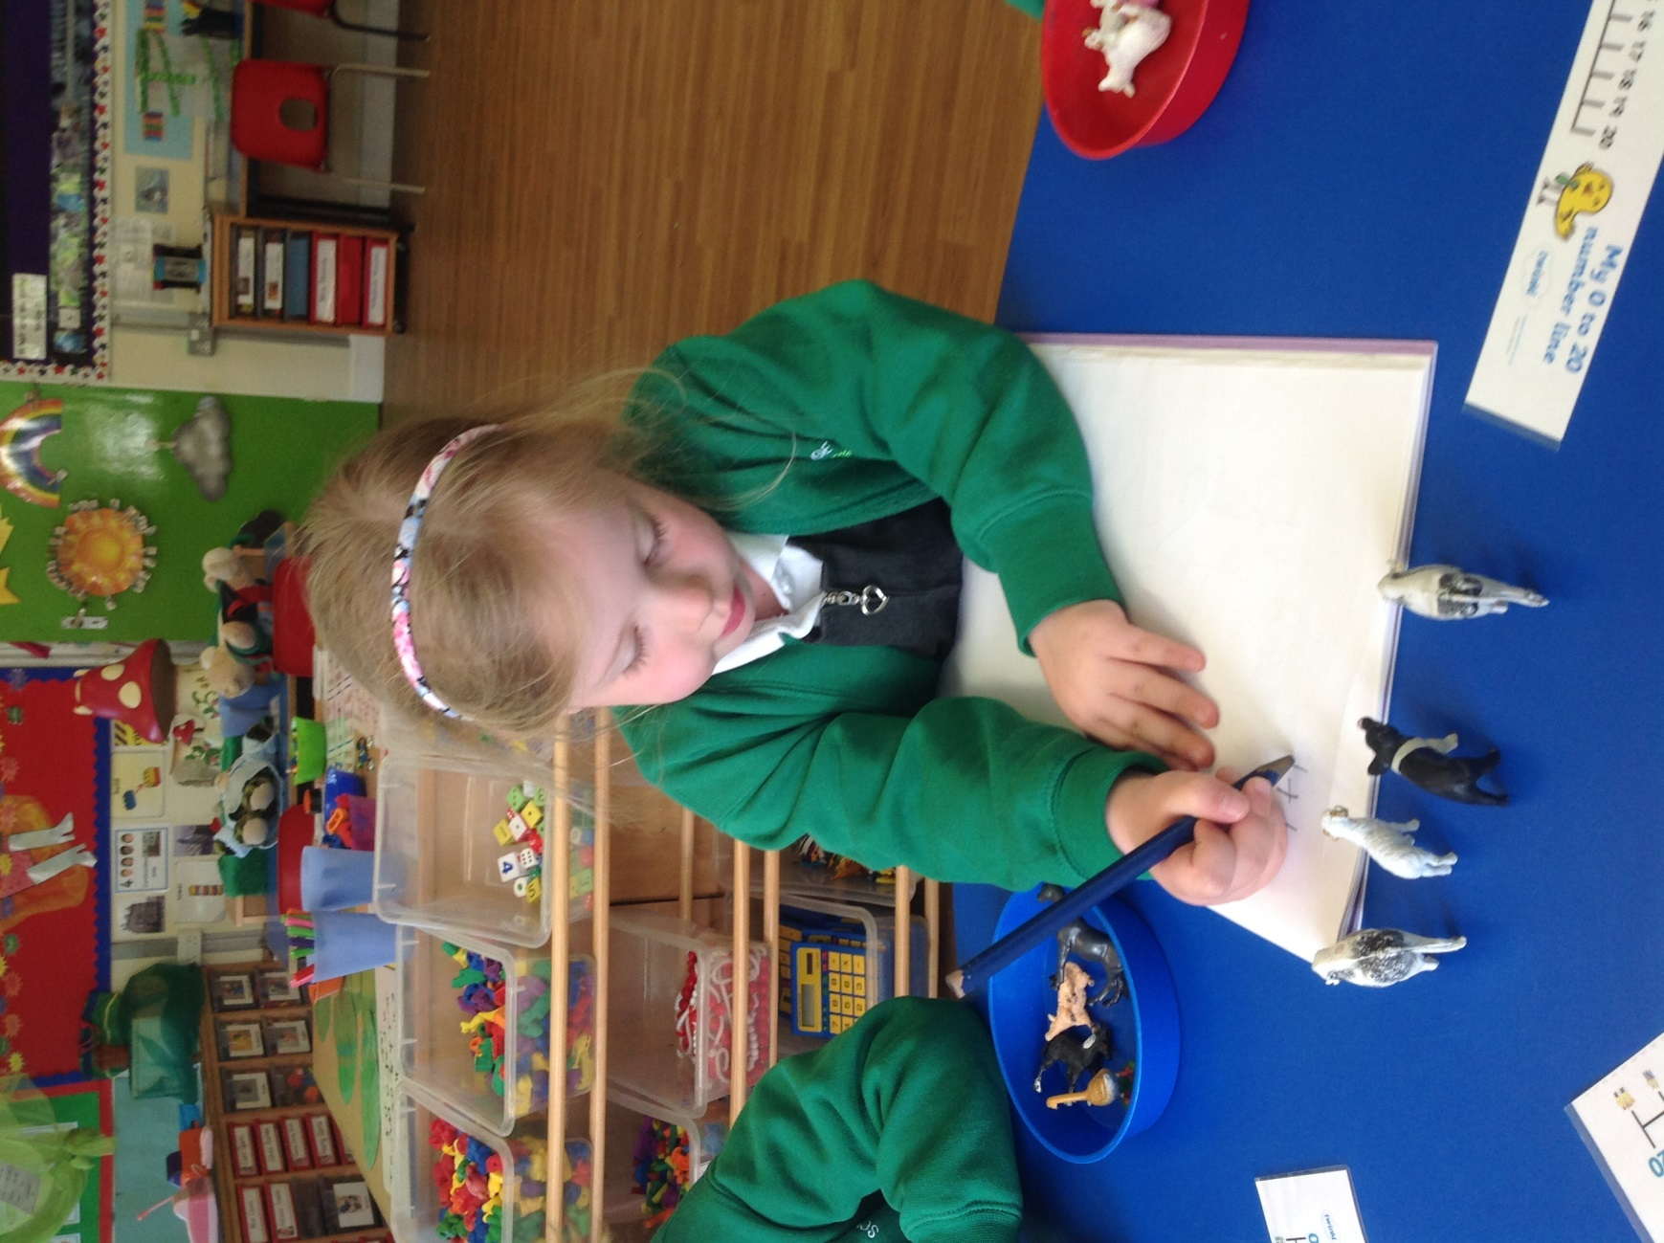
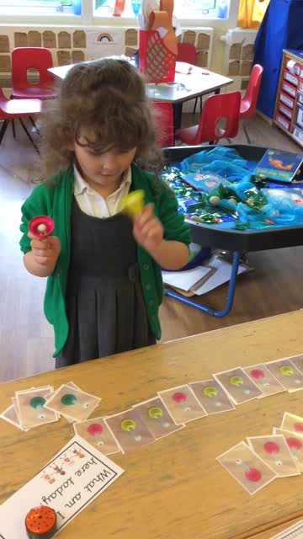
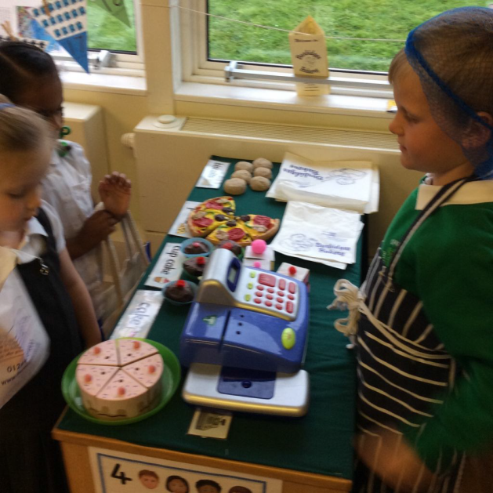
It is...........
Applying learnt skills in a context
Problem solving
The farmer can only have 16 legs in a field. Which animals can he have?
Making repeating patterns to compose a tune in music.
Role play-acting a story, working with friends
Shopping in the Bakery.
Buying things-recognising
the number in the price and counting out the correct number of coins
Counting how many times to play each note.

Slide 7
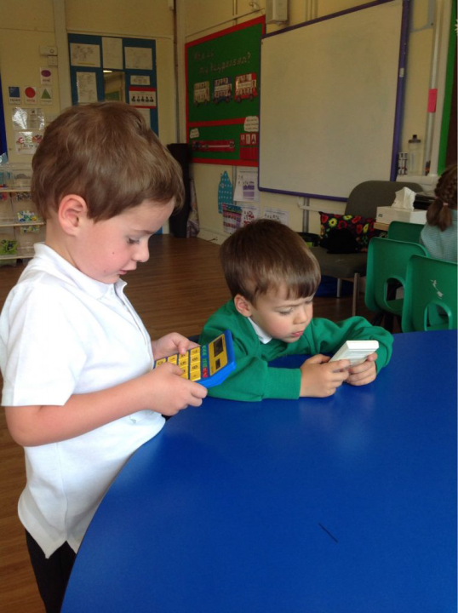
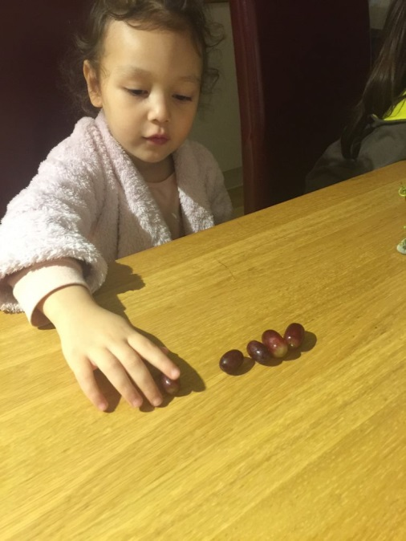
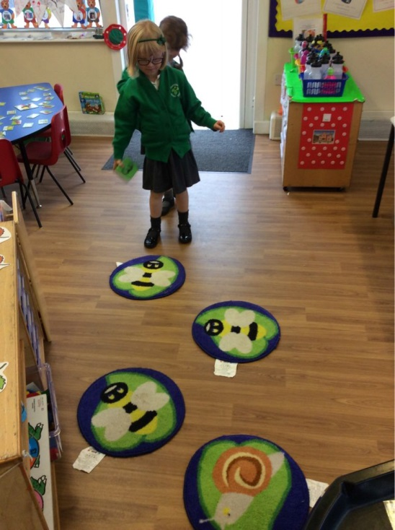
It is....capturing the moment
“We’ve made a game. We roll the dice and then jump that many times on along the mat.”
Exploring numbers on
calculators. “I’ve found a two. Can you find a two?”
Counting grapes
1 more.
Remembering you can use Maths everywhere!

Slide 8
Maths in KS1

Slide 9
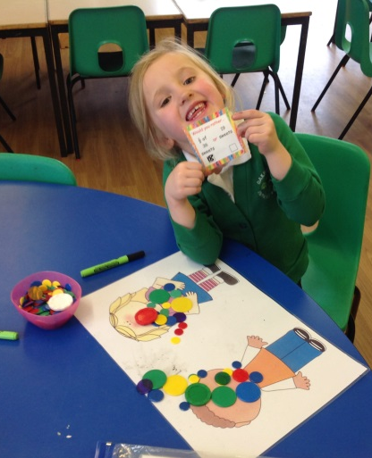
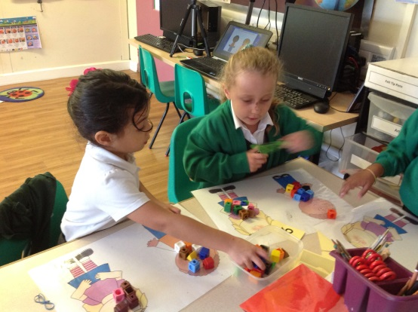
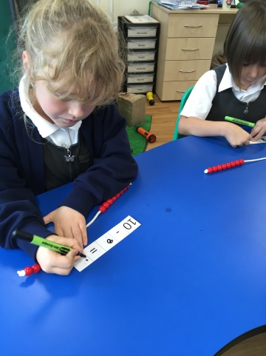
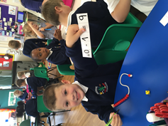
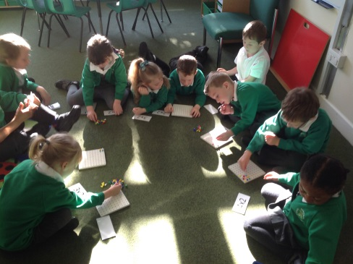
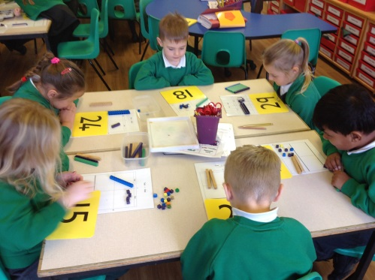
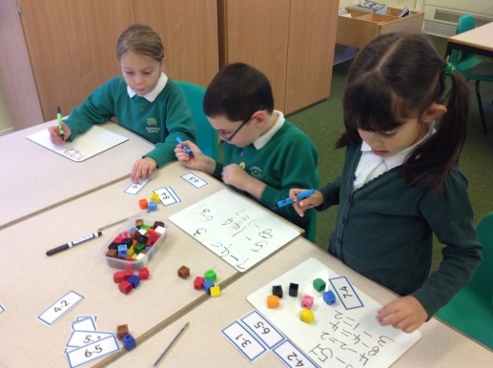
Concrete objects
Using multilink cubes for division by sharing equally.
Solving 2-step fraction problems using counters for sharing.
Using bead strings to support number bonds to 10 and 20.
Making arrays on peg boards to solve multiplication problems.
Recognising the place value of a two digit number using Dienes rods and cubes.
Solving subtraction problems and recording our answers.

Slide 10
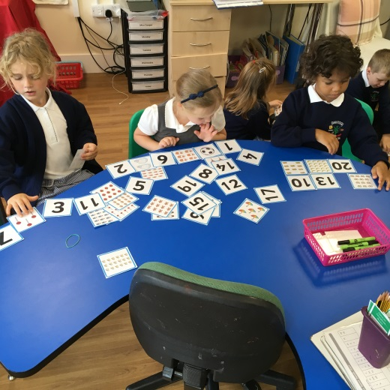
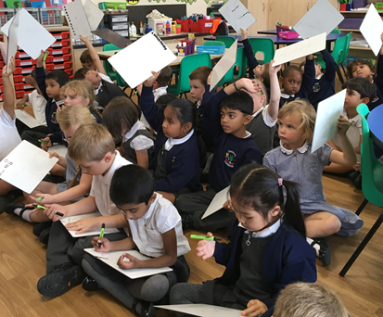
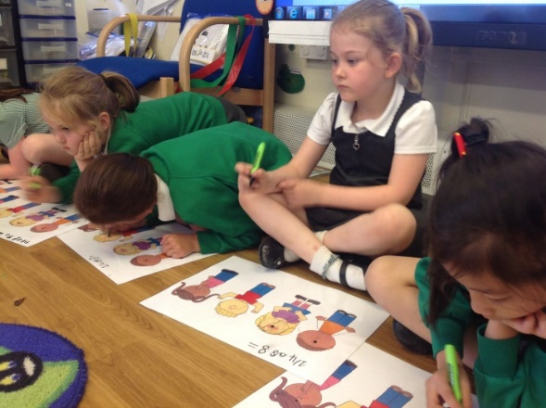
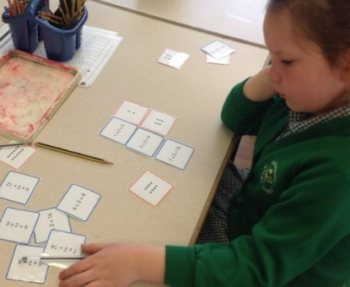
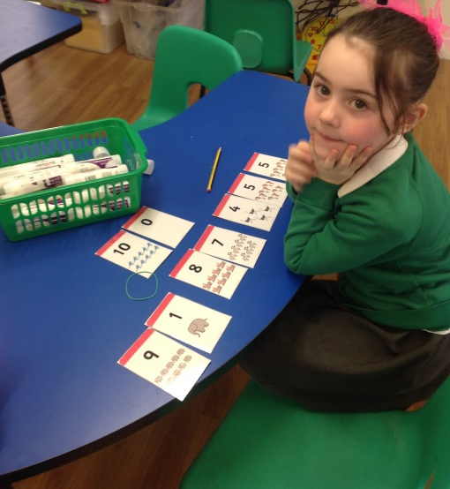
Pictorial Representations
Drawing dots accurately to represent whole numbers
Identifying numbers by counting sets.
Representing multiplication problems using arrays
Using arrays to find ½ and ¼ of a given number.
Number bonds to 10 using images.

Slide 11
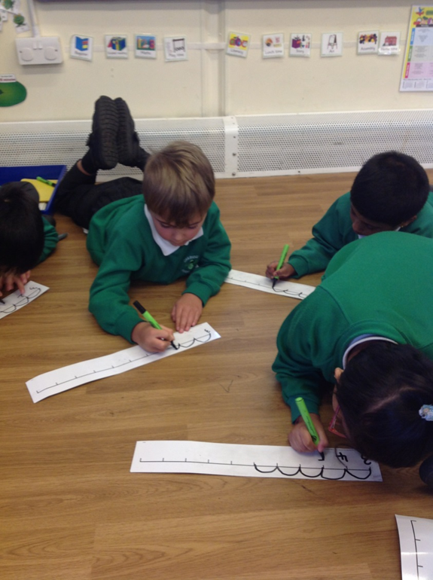
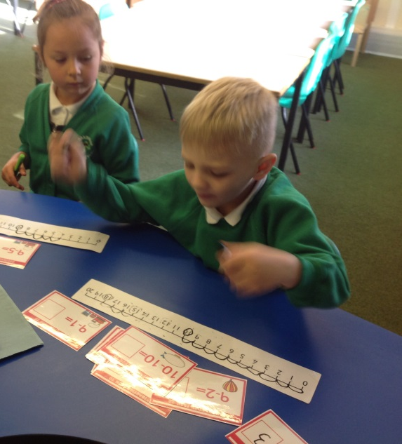
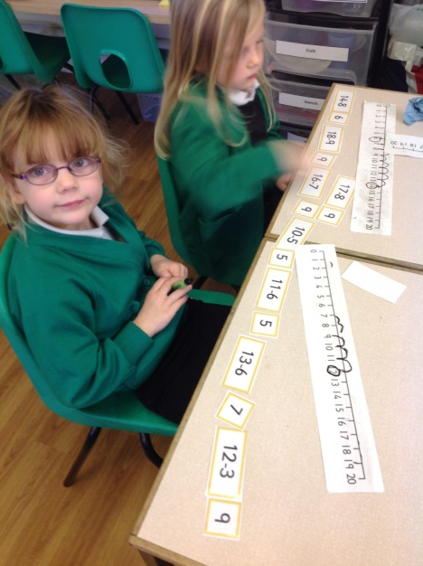
Numberlines
Using structured numberlines for addition and subtraction.
Using unstructured numberlines for addition and subtraction.

Slide 12
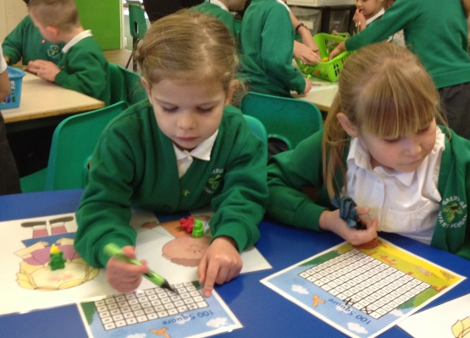
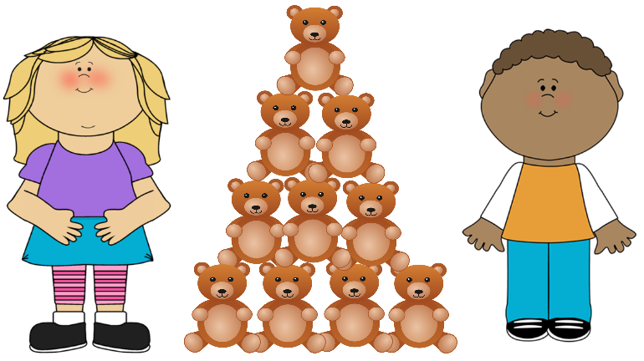
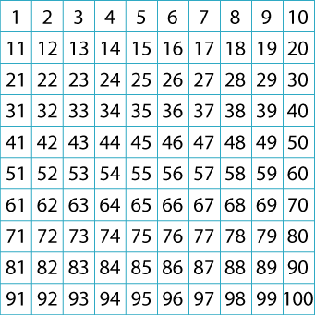
Problem Solving and Mathematical Reasoning
“Max and Sarah have some bears to share. What quantities of bears can they share equally so that there are none left over?”
100 square
“Can 142 bears be shared equally? How do you know?”

Slide 13
KS2 Maths
Arithmetic sessions
(Mental maths, pure number work, using jottings to solve problems mentally)
Reasoning sessions
(Follow the blocks to cover place value, number, shape, time, measurement, geometry etc)

Slide 14
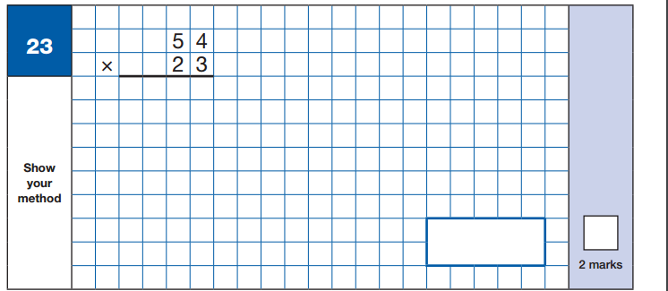
Arithmetic:

Slide 15
Reasoning:

Slide 17
Concrete Apparatus
Number lines
Multiplication squares
Place value cards
Dienes
Numicon
Bar Model

Slide 18
Working towards SATs
ARE = Age Related Expected
Children will be:
Below ARE
ARE
ARE+

Slide 19
What can you do to help?
- Number bonds
Example:
To ten (8 + __ = 10)
To a hundred (34 + __ = 100)
To a thousand (234 + ____ = 1000)

Slide 20
- Times tables
Crucial to maths
Speed
Learning the division facts alongside them
For example: 6 x 7 = 42
Do they know that 42 ÷ 7 = 6?

Slide 21
- Methods for the operations +-x÷
We teach a progression of methods
Important: please don’t teach your child a new method – there’s a reason why they haven’t learnt the short method yet!
Help them to apply the method they are on (hand out) to complete homework or practice addition, subtraction, multiplication and division

Slide 22
Telling the time
Correctly tell the time on an analogue clock
Be able to tell you how long until a given time

Slide 23
Help with homework
Usually have examples provided on homework to help
If stuck please get your child to speak to teacher because we can help
Don’t teach them new methods as they need to consolidate their current method first
No battles!!
No SATs papers please-we do these in class and work through them with the children. If they’ve done it before it won’t help.

Slide 24
Hand Outs provided:
Reception and KS1:
A number line with numicon representation on it from 0-10 and 0-20
Hundred square
Blank number line

Slide 25
Hand outs provided:
KS2:
List of the use of operations from Y3 to Y6
Fractions (add, subtract, multiply and divide)
Times table cards to help with times tables
Number lines to help with their homework

