Slide 1
Wednesday 26th September 2018

Slide 2
‘There is no such thing as a child who hates to read; there are only children who have not found the right book’

Slide 3
What is reading for pleasure?

Slide 4
What does it look like?

Slide 5
Why read for pleasure?

Slide 6
Our role
Reading for pleasure is strongly influenced by relationships between teachers and children, and children and families (Cremin et al, 2009)
Parents and the home environment are essential to the early teaching of reading and fostering a love of reading; children are more likely to continue to be readers in homes where books and reading are valued (Clark and Rumbold, 2006)

Slide 7
What are we doing?
Investment in new books for our classroom libraries
Teachers are taking an active role in supporting children’s choices
Book related incentives
Events to celebrate reading
Inviting reading environments
Reading teachers
Stop.Drop.Read

Slide 8
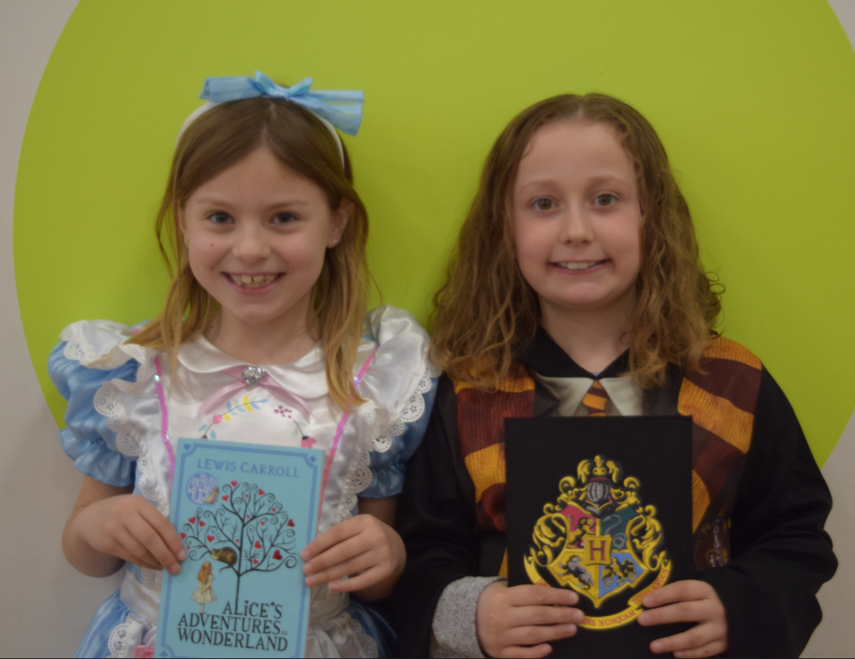
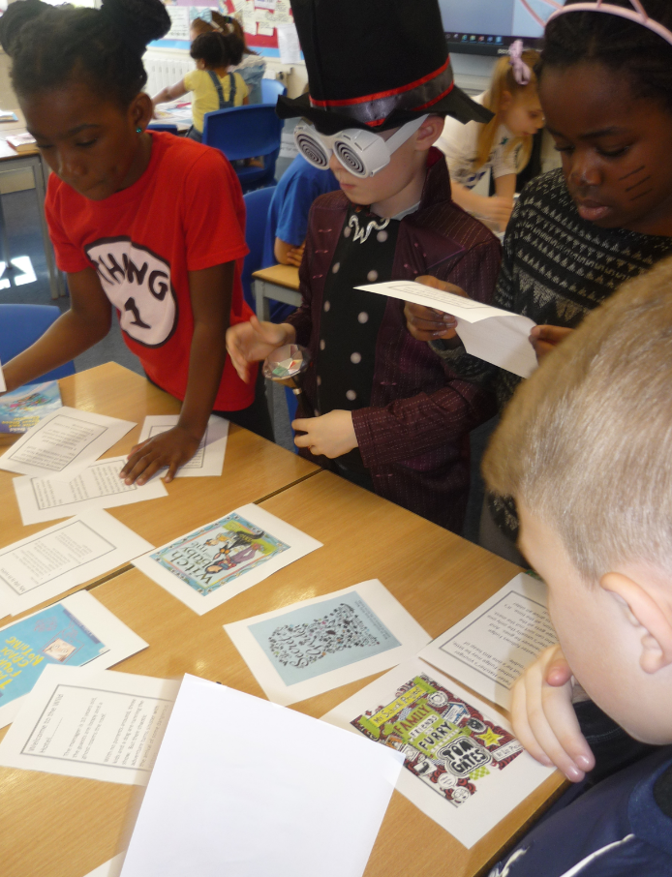
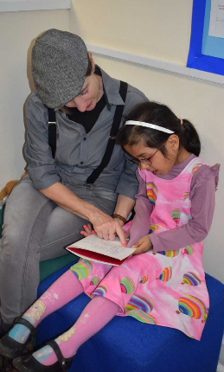
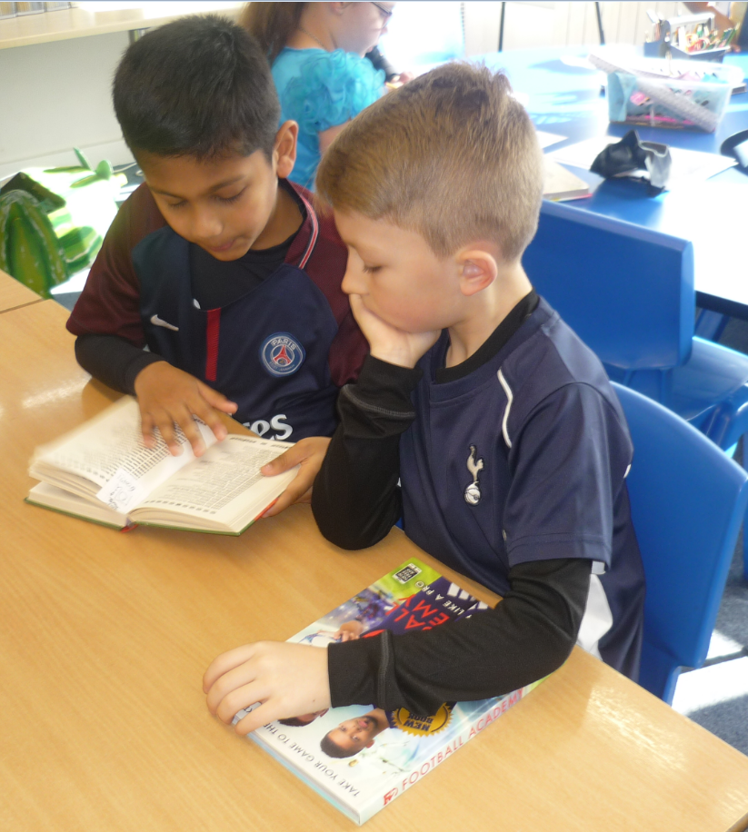
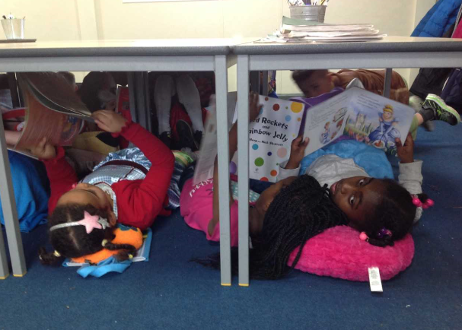
World book day

Slide 9
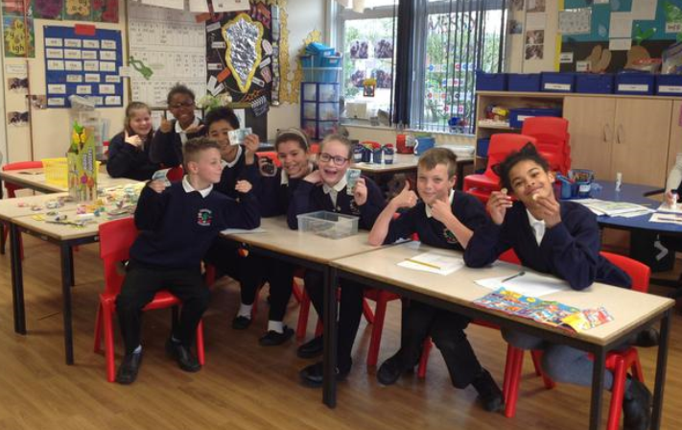
Book fairs

Slide 10
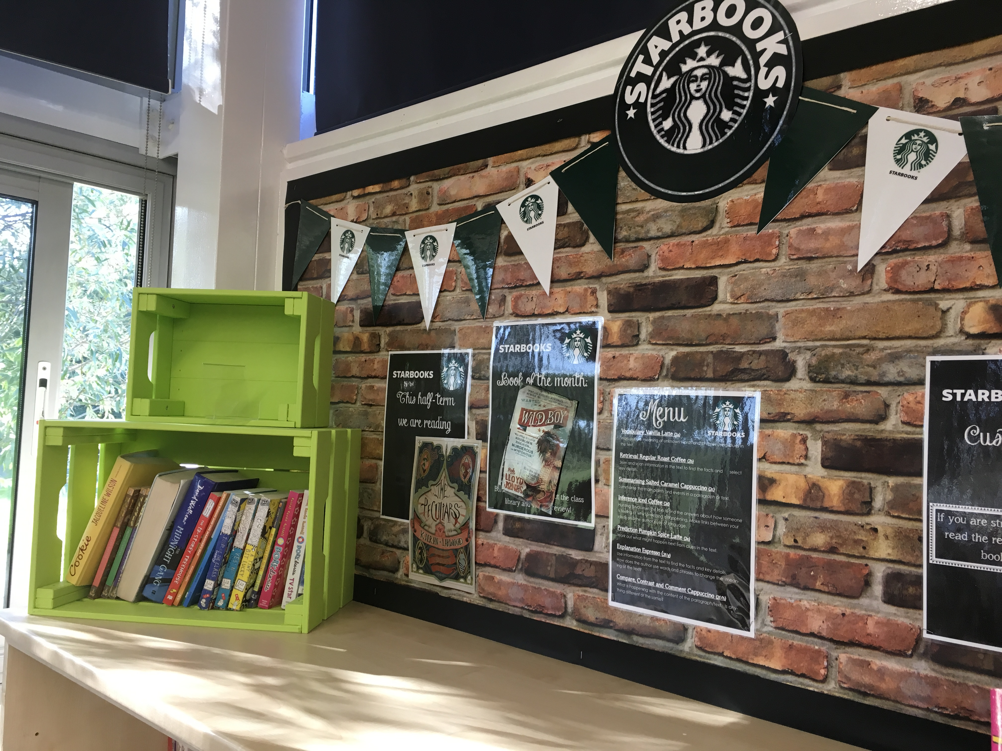
Incentives…

Slide 11
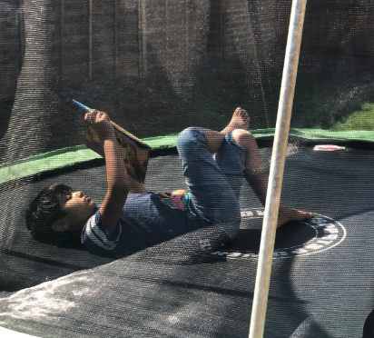
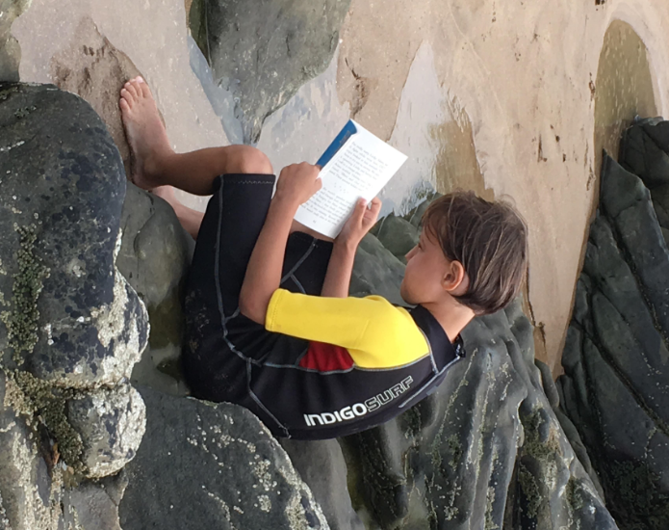
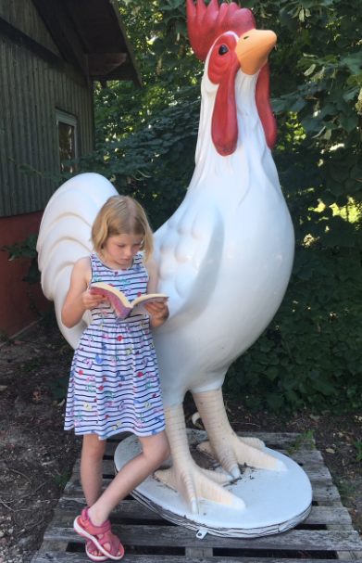
Caught reading in year 3

Slide 12
What can you do?

Slide 13
A useful website…
oakridgejunior
thedayexplorer

