Slide 2
Are you the next…
Jessica Ennis-Hill?
Lionel Messi?
Emma Raducanu?
Mo Farah?
If so, I want to know and if you have received a sports or dance award recently, I want to hear about it!

Slide 3
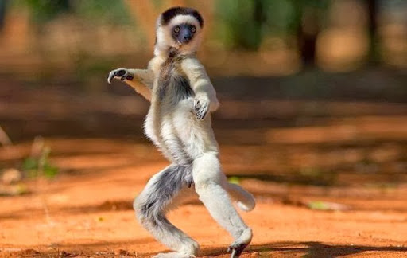

Slide 4
Your award must be from THIS year (from January time onwards).
Anything before this is great but has unfortunately passed its sell-by date for the school display...
It can be from a virtual competition – lockdown has made it tricky for anyone to compete but if you have taken part in something virtual for your team and have got an award, that counts!
Always speak to your teacher FIRST about your award before bringing any medals, trophies or certificates.

Slide 5
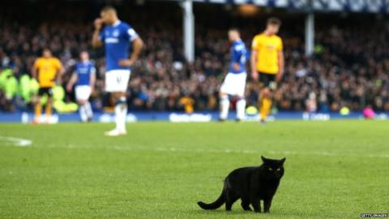
Arrange a time with your teacher to bring in your award.
Say cheese – your teacher will take your photo with your award and will send it to me so I can put you on my Sports Selfie display.
P.S. Make sure that you tell your teacher what your award is for so they can let me know what it’s for – that’s the important part!

Slide 6
From now on, any awards you earn outside of school could get you in the ‘Sports Hall of Fame’…

Slide 7
Remember to check in with your teacher to arrange the best time to bring in your award

Slide 8
Don’t forget the small print we mentioned.
But most importantly: don’t forget to say

